Slide 1
MIKE 11
Dambreak Modelling

Slide 2

DAMBREAK MODELLING
Implementation of Dambreak Structures in MIKE 11

Slide 3
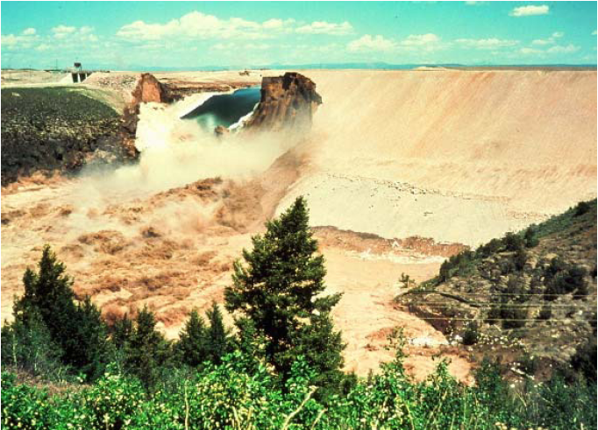
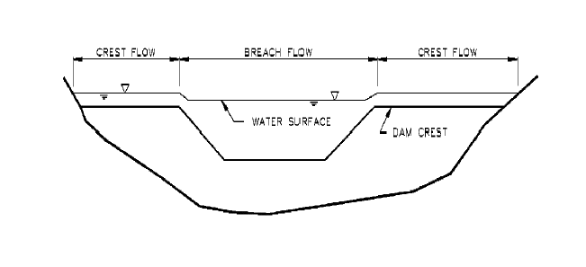
DAMBREAK MODELLING
Dambreak Modelling with MIKE 11 -
The Dambreak Structure:
Flow at Dambreak Structure
Similar to Broad Crested weir flow, except:
  Shape of Dam changes with time
  Breach increase, Dam Crest shortened
Q-h relationship different for Dam crest and breach => Flow over crest and through breach calculated separately.
Breach development is trapezoidal
Defined by:
  breach bottom level
  breach bottom width
  breach side slope
  (horizontal:vertical)

Slide 4
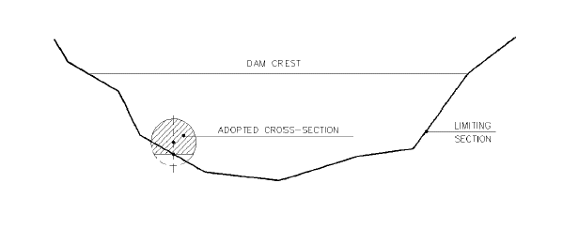
DAMBREAK MODELLING
Two Types of Dambreak Mechanism
Crest Failure:
Erosion Based Failure
Time Dependent Failure
Collapse Shape Specified
Trapezoidal Breach Shape
Piping Failure:
Erosion Based Failure
Time Dependent Failure
Pipe is Horizontal
Orifice Flow
Composite Structure with
Crest and Breach Flow

Slide 5
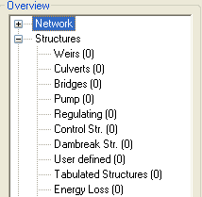
DAMBREAK MODELLING
Defined in the Network File
How? Network File -> View -> Tabular View -> Structures Page
Two Breach Calculation Methods:
NWS DAMBRK Equation
- Breach Failure Mode
- Piping Failure Mode
MIKE 11 Energy Equation
- Time Dependent Failure Mode
- Erosion Based Mode

Slide 6
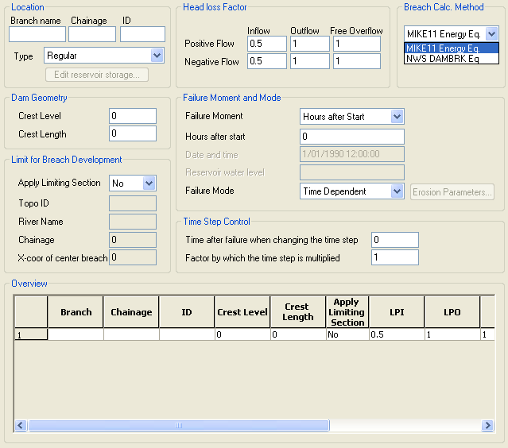
DAMBREAK MODELLING
Dambreak Structures Page (Overview)
Define Location
Initial Dam Crest Geometry Prior to Breach
Different
selections
activate
different
menus in the
Interface
Used to Speed up the Simulation after the Initial Breach (Time in Hours)

Slide 7

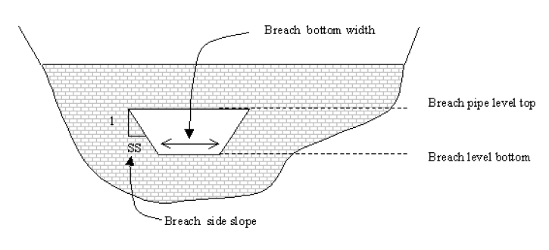
DAMBREAK MODELLING
NWS DAMBRK Equation
National Weather Service Method:
Uses DAMBRK Equations for
- Crest Failure (Weir Flow)
- Piping Failure (Orifice Flow)
Full Breach Geometry must be
Defined in a Time Series
- Bottom Width
- Bottom Level
- Side Slope
For Piping Failure,
- “Upper Level of Pipe”
must also be defined
- Pipe is Trapezoidal
Refer to MIKE 11 Reference Manual for Definition of Terms

Slide 8
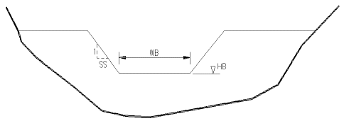
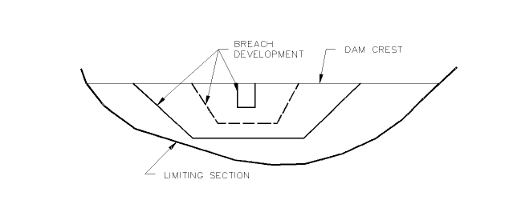
DAMBREAK MODELLING
MIKE 11 Energy Equation (Time Dependent)
Time Dependent Mode:
Trapezoidal Breach
- HB (Breach Level)
- WB (Breach Width)
- SS (Breach Slope)
slope = horizontal:vertical
Temporal Development
- Defined as a Time Series
- Assigned in the Boundary File
Weir Flow
- Broad Crested Weir Equation
- Applied Separately to Crest
Flow and Breach Flow

Slide 9
DAMBREAK MODELLING
MIKE 11 Energy Equation (Time Dependent)
Engelund-Hansen Sediment Transport:
Breach Failure Initially (overtopping)
Piping Failure Initially (full running, horizontal circular pipe)
H_{b} = Breach Level
W_{b} = Breach Width
H_{b} = Breach Height
R_{p} = Pipe Radius
q_{t} = Sediment Transport Rate
x = Side Erosion Index
L_{b} = Breach Length
L_{p} = Pipe Length
ε = Flow Direction
For More Information, Refer to the MIKE 11 Reference Manual

Slide 10
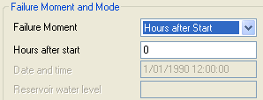


DAMBREAK MODELLING
Dambreak Parameters (Failure Moment)
Three Failure Moments:
Hours after Start
(Relative to Start of Simulation)
Date and Time
(Must be within Simulation Period)
Reservoir Water Level
(Breach commences when Upstream
Reservoir Level Reaches Set Level)

Slide 11

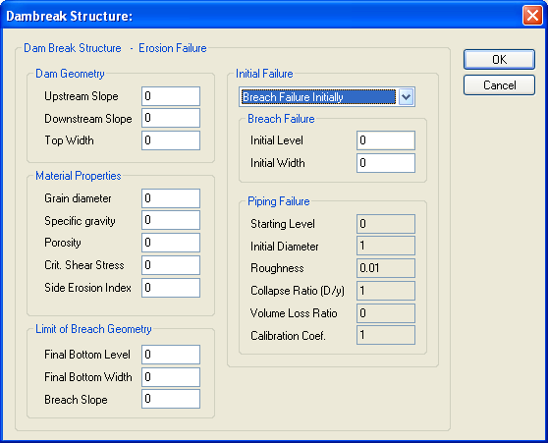
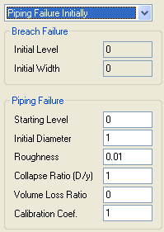
DAMBREAK MODELLING
Dambreak Parameters (Erosion Parameters)
Dam Geometry
Initial and Limiting
Breach Geometry
Material Properties
and Parameters
Upstr.
slope
Top width
Q
Downstr.
slope
Q
Initial Failure Either Breach (Overtopping) or Piping

Slide 12
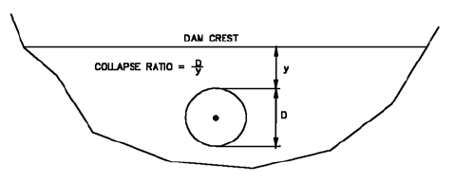
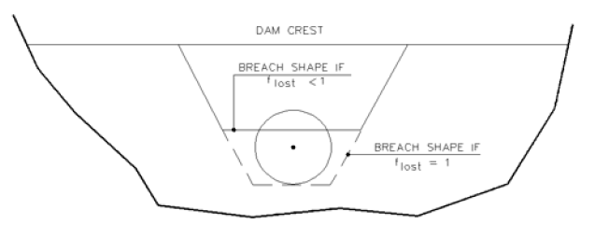
DAMBREAK MODELLING
Erosion Parameters (Values and Definitions)
Pipe failure, collapse of breach above pipe.
Definitions and Guidelines:
All Slopes (1 v : X h)
Specific Gravity (2.5-2.7)
Porosity (0.3-0.5)
Critical Shear Stress (0.03-0.06)
Collapse Ratio Defines the Point
at which the Pipe will Collapse
Volume Loss Ratio (f_{lost}) Defines
the Breach Shape after Collapse
Calibration Coefficient Adjusts
the Rate of Change of the Pipe
Radius

Slide 13
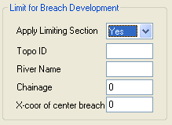
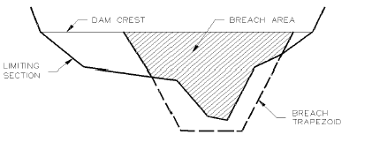
DAMBREAK MODELLING
Limiting Section
Applies to Both Time Dependent
and Erosion Based Breaches
Refers to the Cross-Section Database
Crest Length in Initial Dam Geometry
is also Limiting
Limiting Section Overrides
Limit Defined In Erosion
Parameters

Slide 14
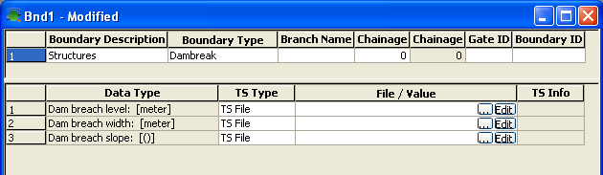
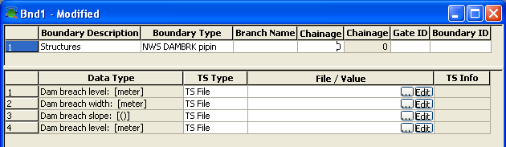
DAMBREAK MODELLING
Links to the Boundary File (Time Dependent)
Must be Located at Same Chainage as Dambreak Structure in Network File
Temporal Data for Breaches
are contained in a Time Series File
Assigned in the
Boundary File as
a Structure Boundary
NWS DAMBRK
Boundary has Extra Row
(Upper Level of Pipe)

Slide 15
DAMBREAK MODELLING
Schematisation in MIKE11
RESERVOIR
Can be Defined using Additional Storage Area in Processed Data of the Upstream Cross-Section (H-Point)
SPILLWAY BRANCH
Spillway Structure (Defined Q-h Relationship) can be “Offline”
MAIN BRANCH
Dambreak Structure
WEIR
WEIR
STRUCTURE
STRUCTURE
Spillway Branch
Spillway Branch
Main Branch
Main Branch
RESERVOIR
DAM BREAK
STRUCTURE

Slide 16
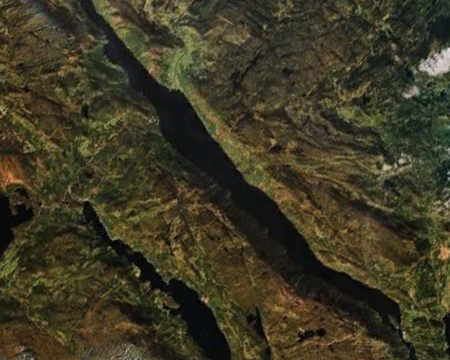
DAMBREAK MODELLING
Schematisation in MIKE 11 - RESERVOIR SCHEMATISATION, Options:
Option 1:
Single cross section
Often artificial section
Reservoir storage volume
manually defined and
calibrated through
Add. Flooded Area
(processed data)
Option 2:
Multiple sections
Reservoir storage volume
defined in Add. Flooded Area
(processed data)
Reservoir LEVEL-VOLUME Relation MUST be Calibrated

Slide 17
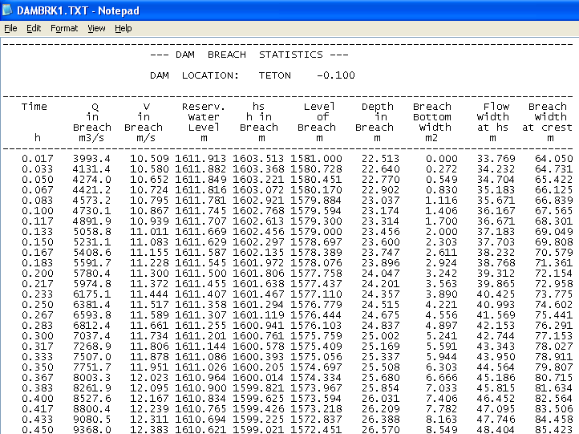
DAMBREAK MODELLING
Summary of Dambreak Statistics (DAMBRK#.TXT)
Dambreak statistics file created for each Dambreak structure in setup (dambrk1.txt, dambrk2.txt etc.).
Summary Data for Each Saved Step in Simulation
Discharge and Level Data for Breach
Located in Same
Directory as the
SIM11 File

Slide 18
DAMBREAK MODELLING
Hints on Dambreak Modelling in Practice:
Breach of a Dam often creates a fast moving flood wave
=> High risk of instability in model simulations.
Solution measures:
- Small timestep or Adaptive timestep,
- Increased Delta (HD11 parameter file)
- If river reaches downstream of Dam is practically dry, insert small
‘stability flow’ lateral source to improve model stability
Stable and ‘healthy’ initial conditions must be prepared prior to activating the Dambreak
Eventually make a Steady state profile for Dam/reservoir and river reaches by use of a Weir at the Dam location.

Slide 19
DAMBREAK MODELLING
Dambreak modelling in practice:
Initial conditions prior to dam failure in simulation (Important!):
  Often, dam failures occur with dry river downstream.
  Dry rivers must be treated with care in MIKE 11 models generally!
  Recommended to make ‘steady-state’ hotstart-file to use for Dambreak scenarios.
  Created by:
  - add small lateral source to first h-point downstream of dam,
  (secures an initial depth in river receiving dam-outflow)
  - Inflow to reservoir can be zero/non-zero
  - Dambreak structure defined not to fail (by breach definitions or
  by substituting dam structure with standard weir)
  Hotstart file often requires a sequence of simulations with increasing timesteps (starting from very small timestep and increasing)
  Reduce file-size of final hotstart file:
  - Run hotstart from stable and well-defined hotstart over short
  period of time.

Slide 20
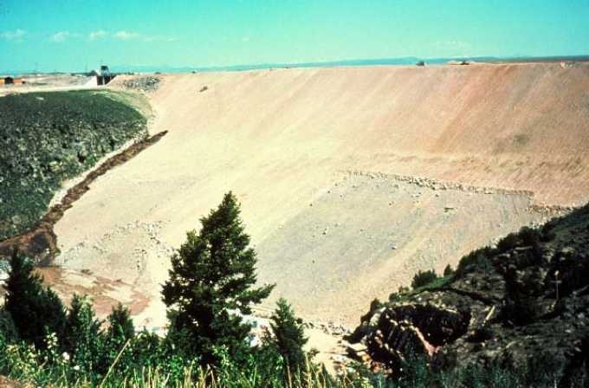
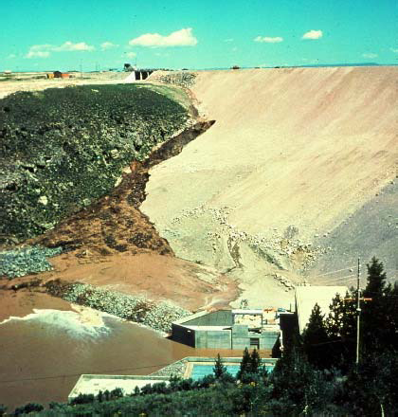
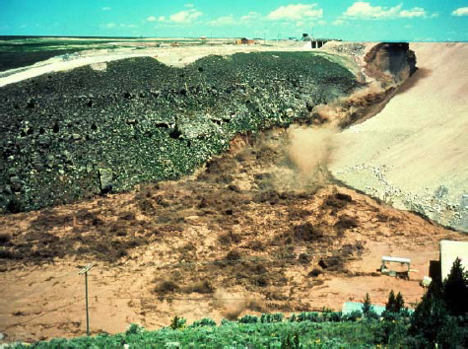
DAMBREAK MODELLING
Illustrated Example (Teton Dam, Idaho, USA)
Failed on June 5, 1976

Slide 21
DAMBREAK MODELLING
Regulations and Guidelines (Australia)
ANCOLD GUIDELINES – Adopted by Regulators
Guidelines on Assessment of the Consequences of Dam Failure (ANCOLD, May 2000)
Guidelines on Selection of Acceptable Flood Capacity for Dams (ANCOLD, March 2000)
These guidelines include definitions of:
Severity of Damage and Loss
Incremental Flood Hazard Category (IFHC)
Acceptable Flood Capacity

Slide 22
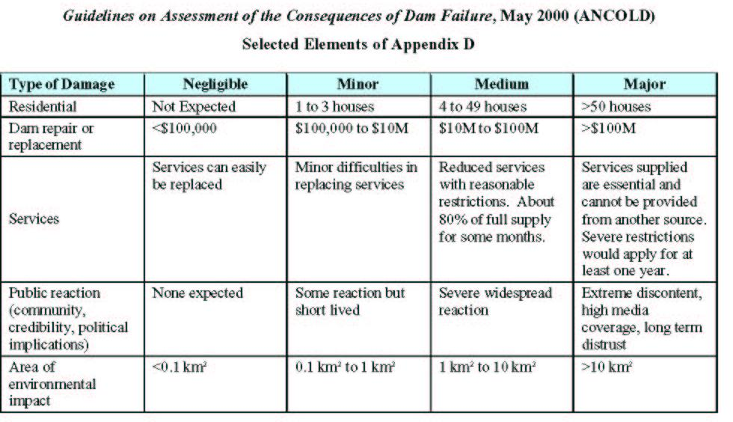
DAMBREAK MODELLING
ANCOLD (Severity of Damage and Loss)

Slide 23
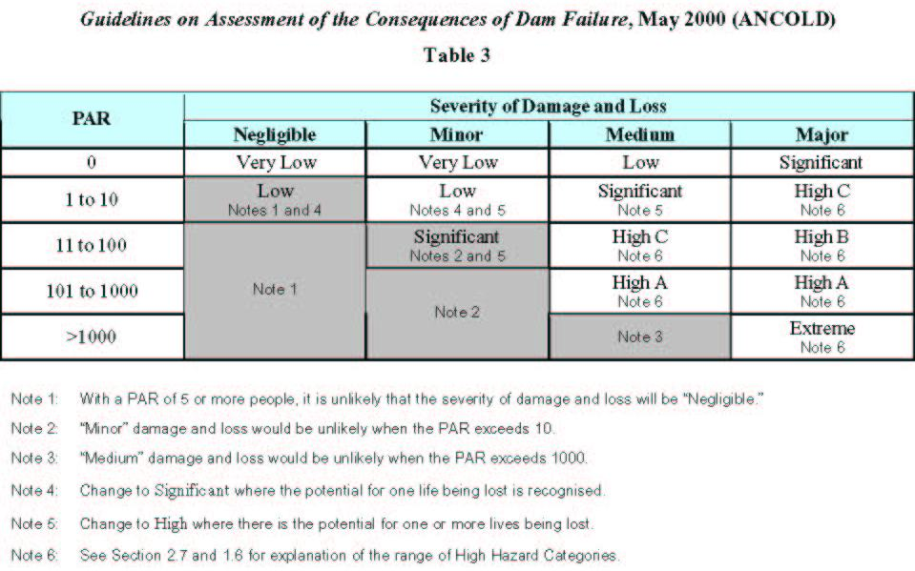
DAMBREAK MODELLING
ANCOLD (Flood Hazard Category)

Slide 24
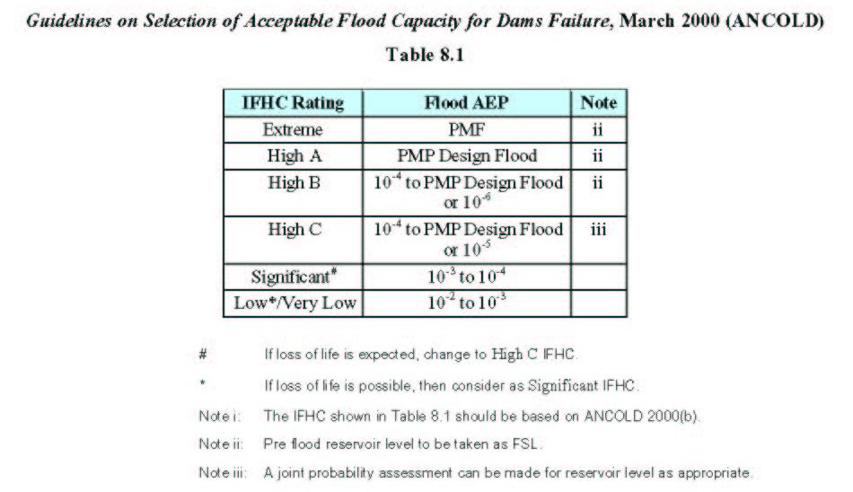
DAMBREAK MODELLING
ANCOLD (Acceptable Flood Capacity)

